Slide 1
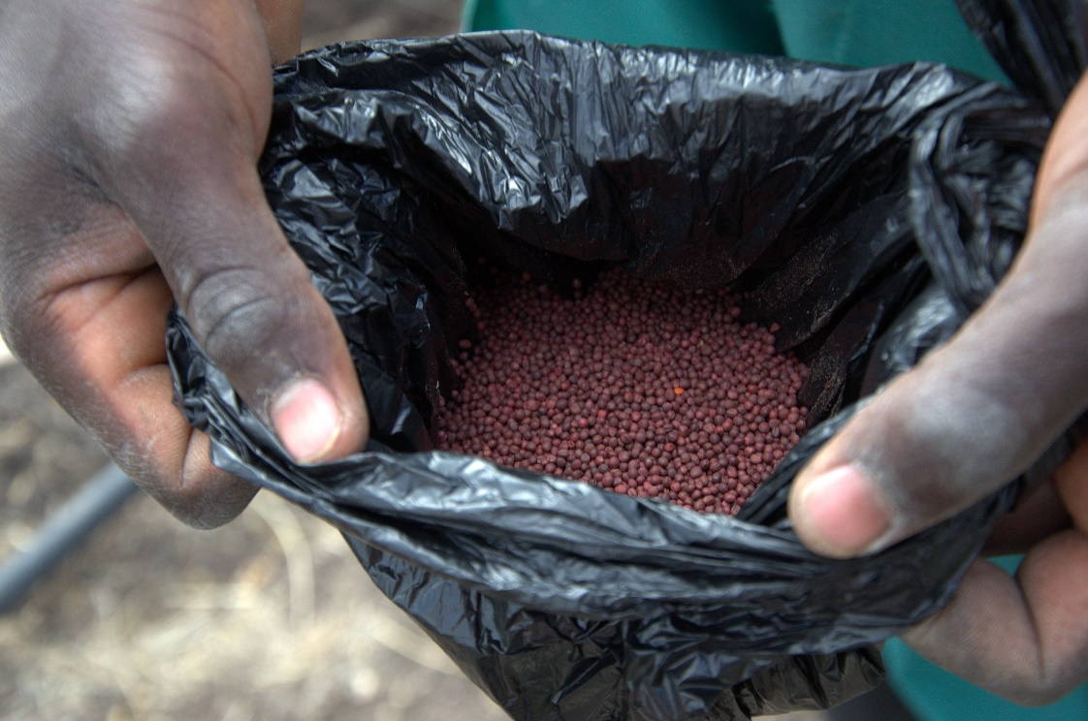
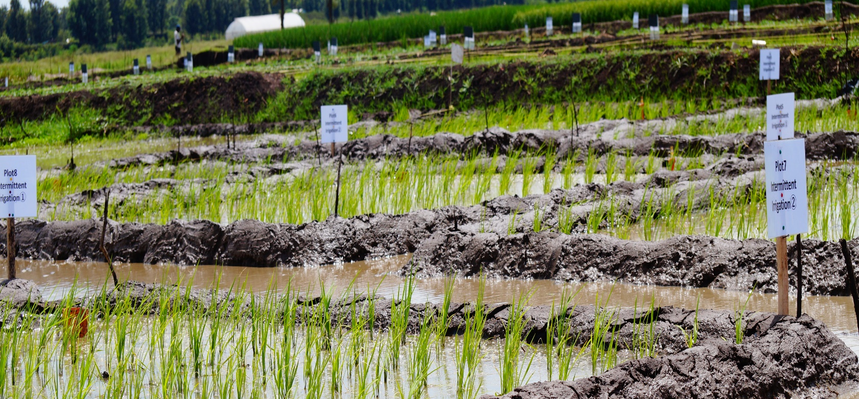
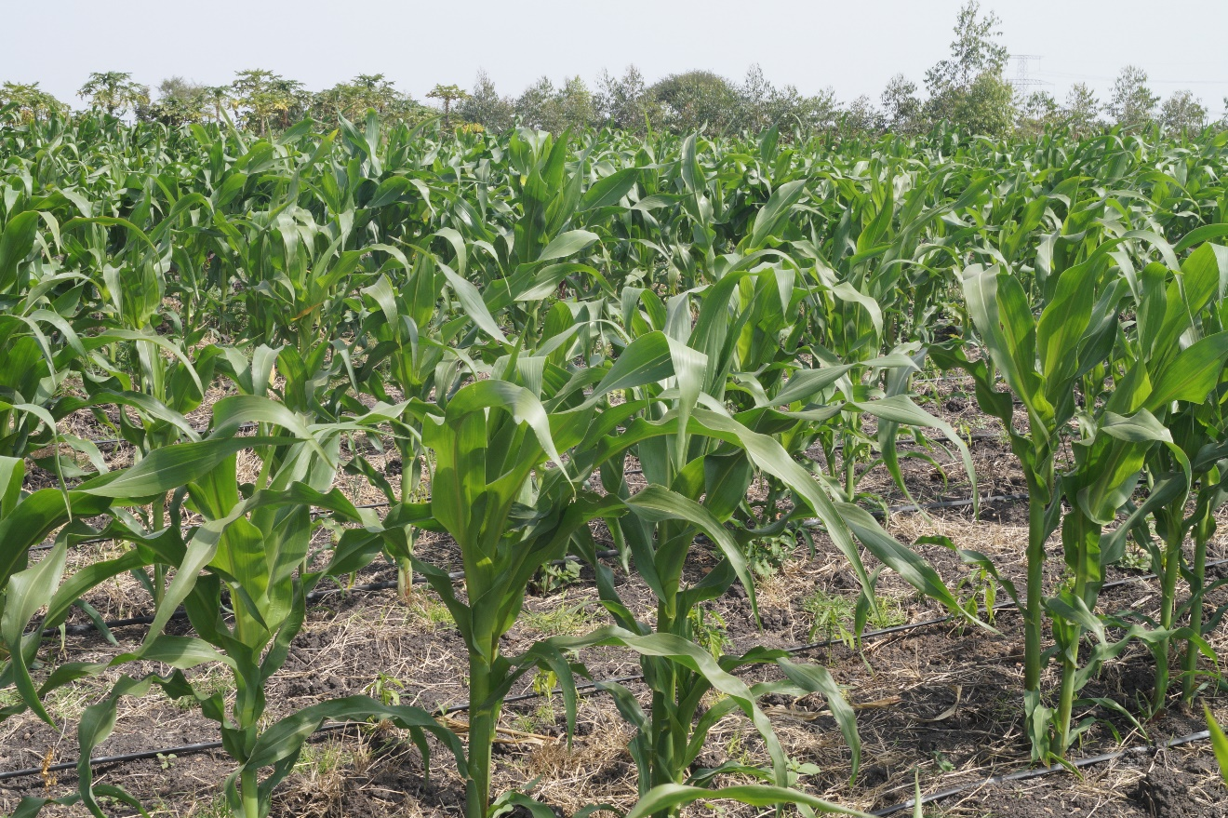
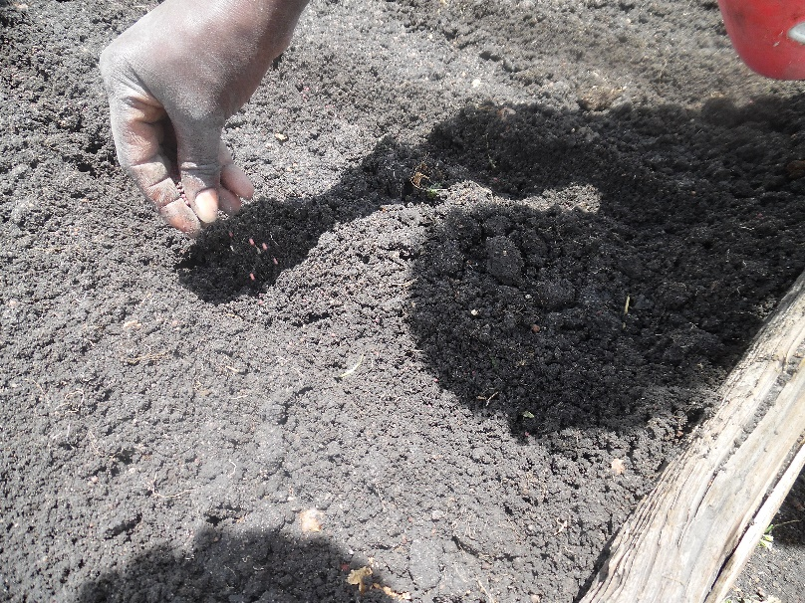
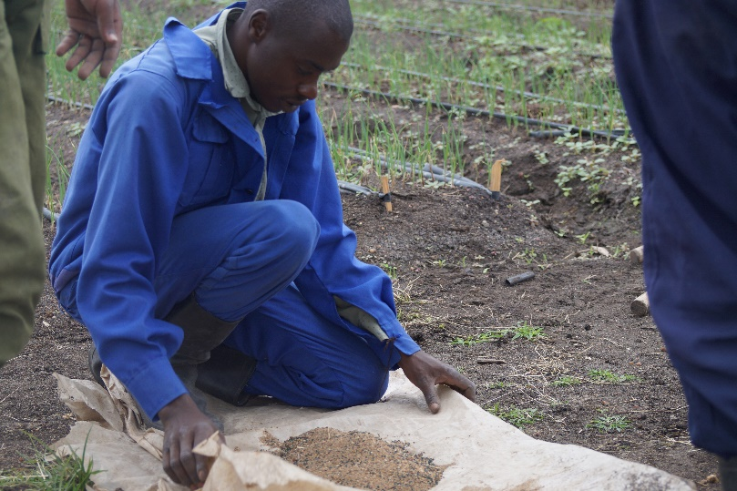

Slide 2
The Opportunity
The Problem
Online Marketing
Network Marketing
54.8% - 22.3 million internet users
75% - 33 million farmers
Cloud-Computing
Arising young & middle-aged farmers – mobile & tech-savvy
Inefficient methods to directly interact with farmers on real-time, making more sales.
Inefficient methods to get direct feedback from farmer-customers

Slide 3


Slide 4
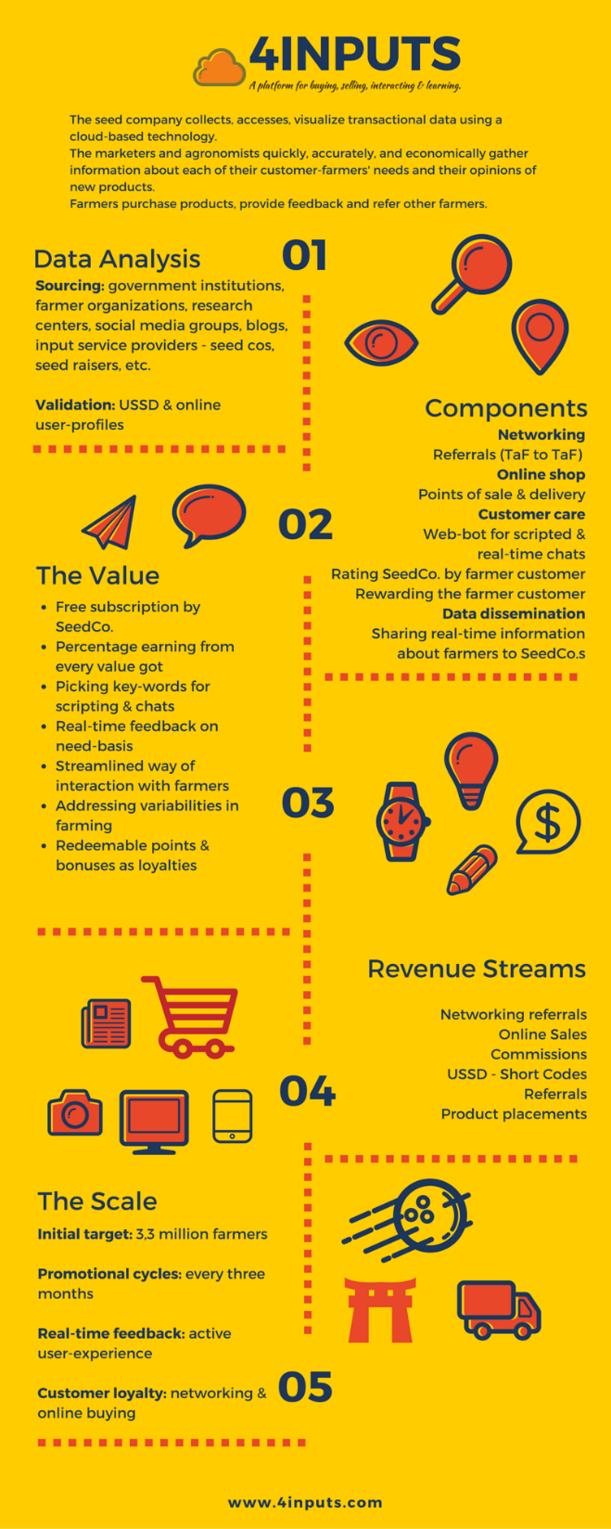

Slide 5
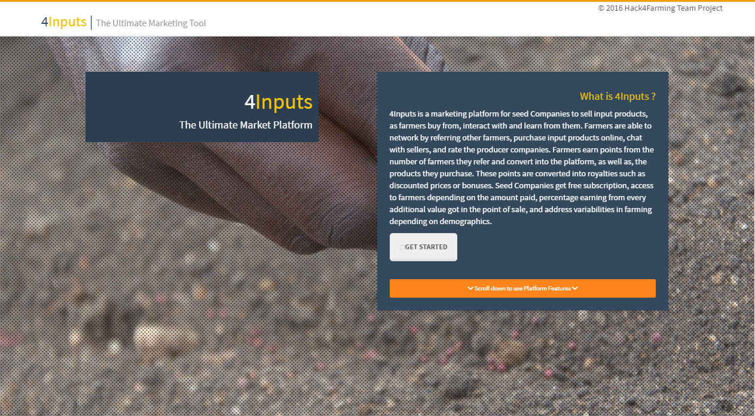

Slide 6
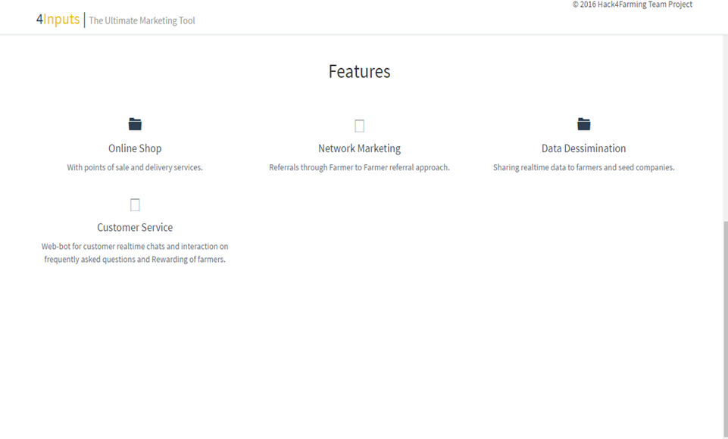

Slide 7
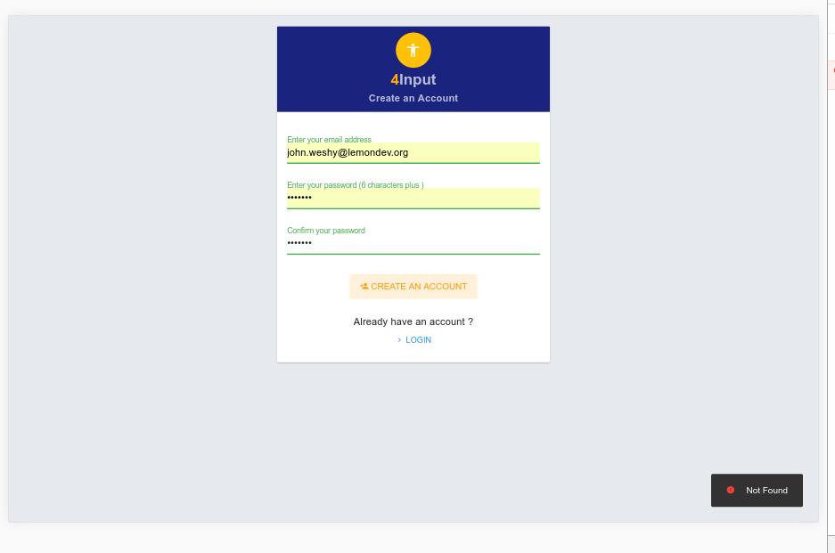

Slide 8
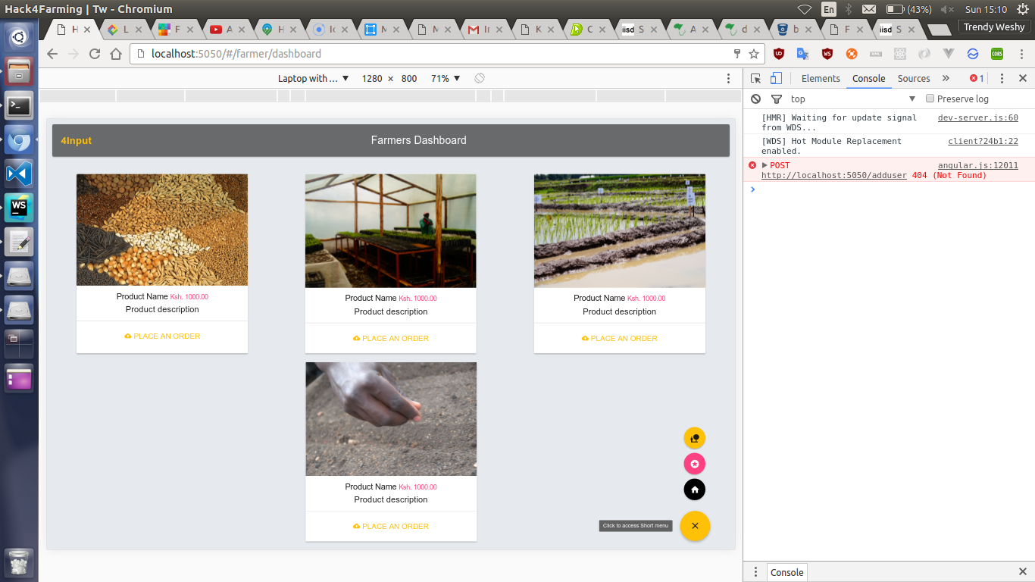

Slide 9
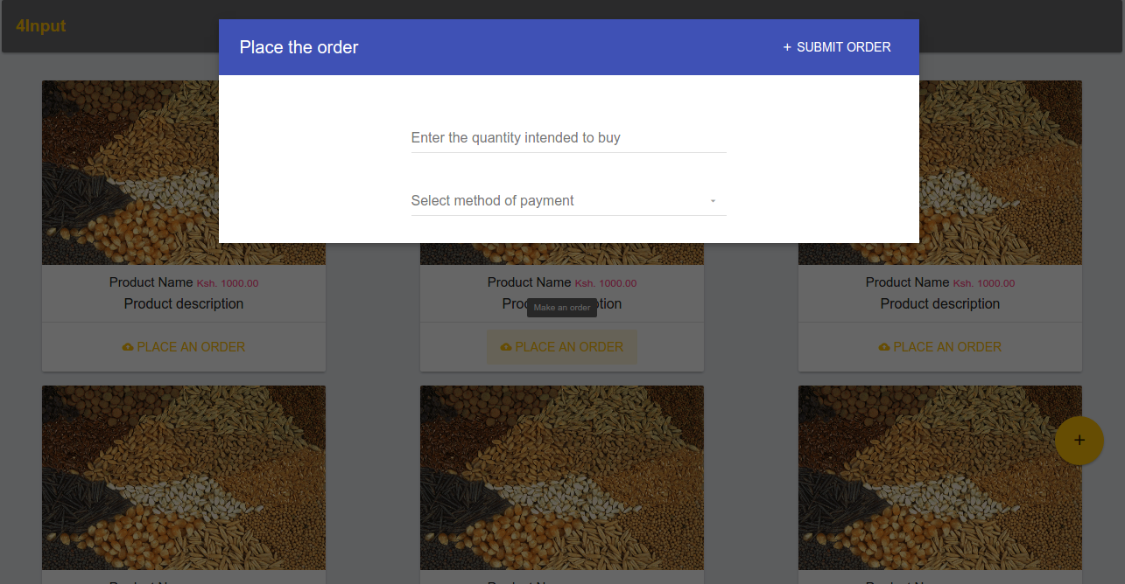

Slide 10
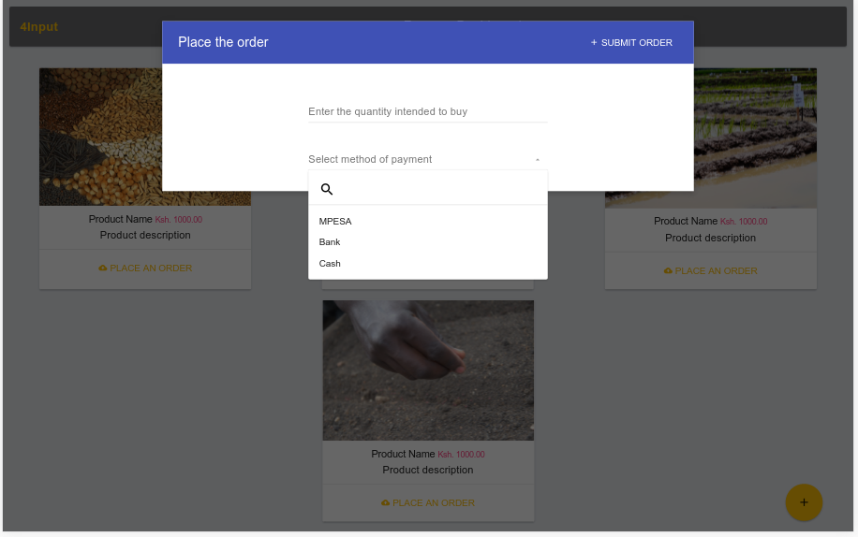

Slide 11
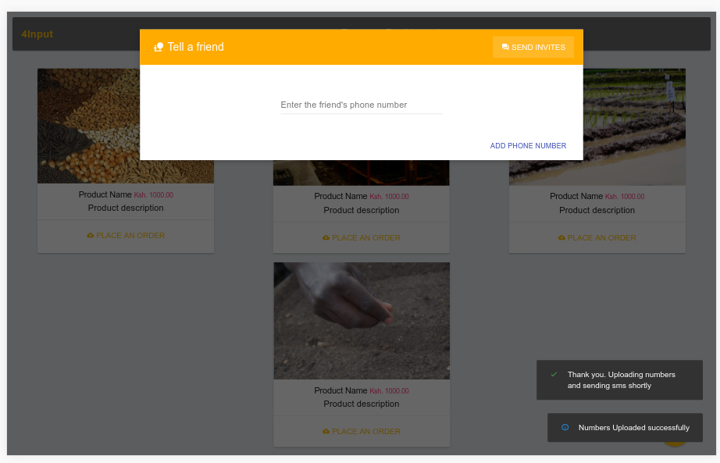

Slide 12
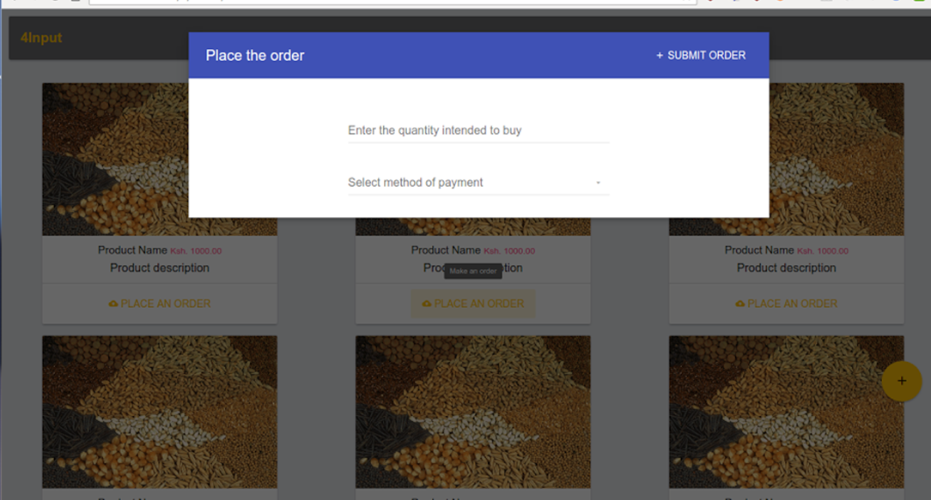

Slide 13
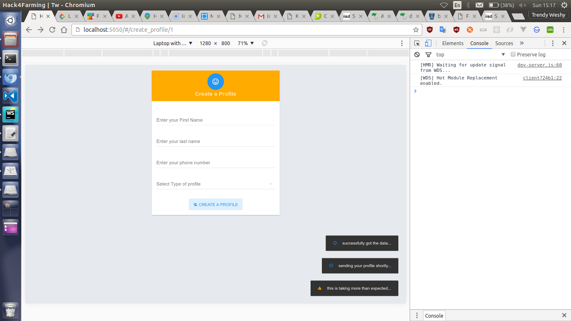

Slide 14
Team 4INPUTS
John Wambugu - waweruj00@gmail.com
Full stack development
Terrence Nzaywa – nza.Terrence@gmail.com
Full stack development
Grace Jayo – gwaguthii@gmail.com
Brand development & engagement
Douglas Mbura – douglas.mbura@gmail.com
GIS Specialist

